Slide 1
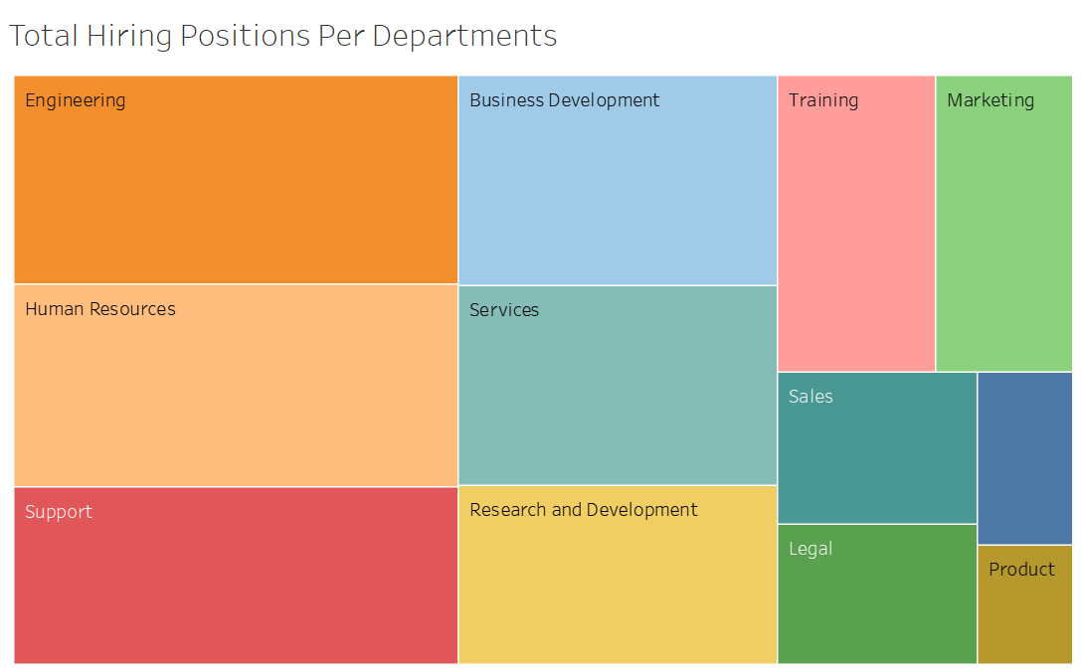


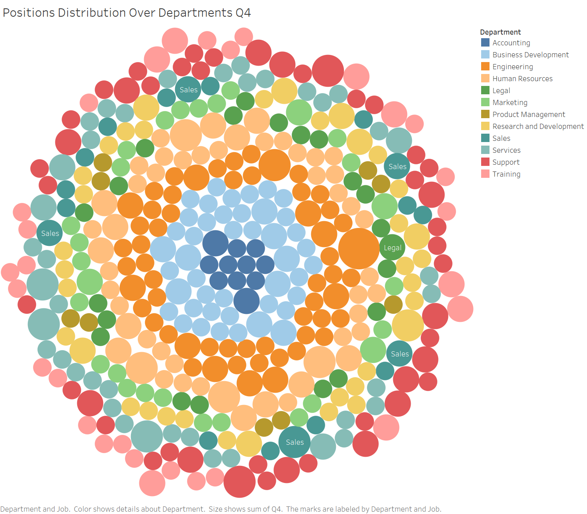


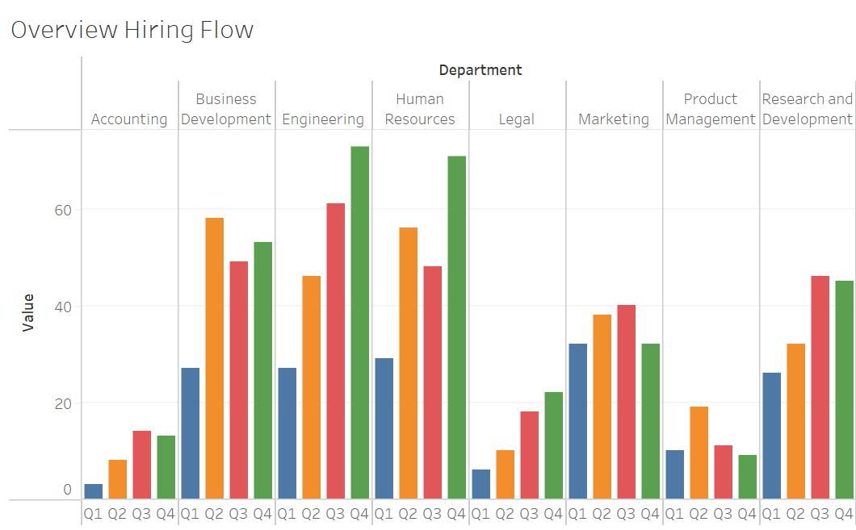
Data Architecture Challenge
Aggregation SQL Script Part 1
assigned as a job in DB
Visualization Tool
Postgres DB
Aggregation SQL Script Part 2
assigned as a job in DB

